Slide 1

TREE DATA STRUCTURE

Slide 2
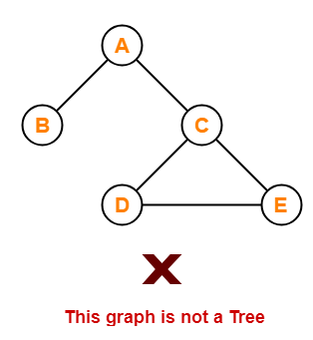
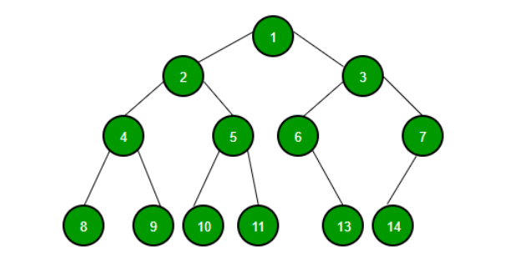
Definition
Tree can be defined as the collection of entities (nodes) linked together in hierarchy. (Non-linear data structure)

Slide 3
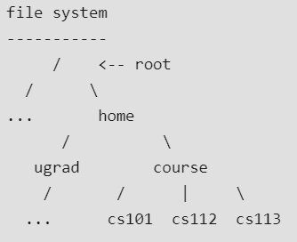
Why Tree Data Structure ?
1. One reason to use trees might be because you want to store information that naturally forms a hierarchy. For example, the file system on a computer.
2. Trees (with some ordering e.g., BST) provide moderate access/search (quicker than Linked List and slower than arrays).
3. Trees provide moderate insertion/deletion (quicker than Arrays and slower than Unordered Linked Lists).

Slide 4
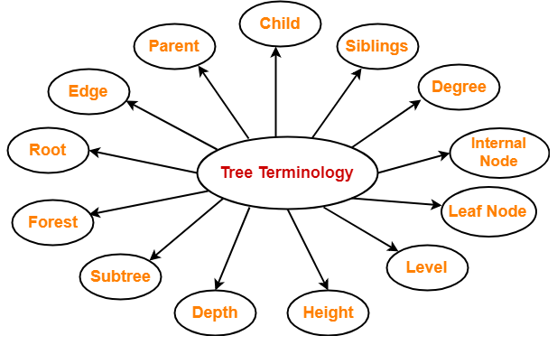
Basic Terminologies of Tree
Note: In tree, if there are ‘n’ nodes then there will be (n-1) edges.

Slide 5
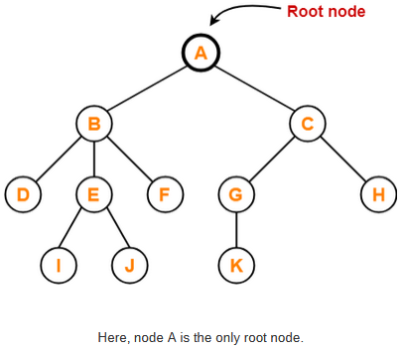
1. Root-
The first node from where the tree originates is called as a root node.
In any tree, there must be only one root node.
We can never have multiple root nodes in a tree data structure.

Slide 6
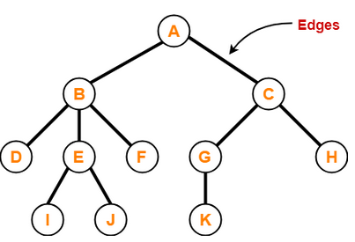
2. Edge-
The connecting link between any two nodes is called as an edge.
In a tree with n number of nodes, there are exactly (n-1) number of edges.

Slide 7
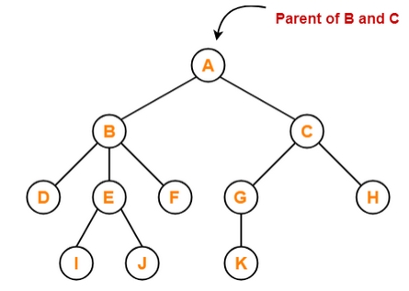
3. Parent-
The node which has a branch from it to any other node is called as a parent node.
In other words, the node which has one or more children is called as a parent node.
In a tree, a parent node can have any number of child nodes.

Slide 8
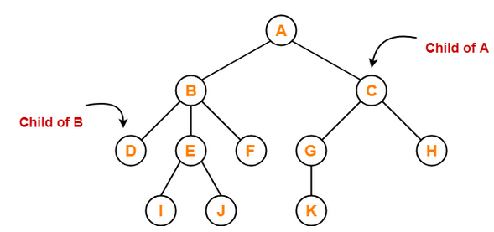
4. Child-
The node which is a descendant of some node is called as a child node.
All the nodes except root node are child nodes.

Slide 9
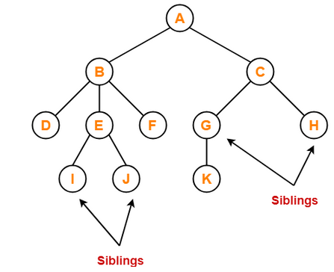
5. Siblings-
Nodes which belong to the same parent are called as siblings.
In other words, nodes with the same parent are sibling nodes.

Slide 10
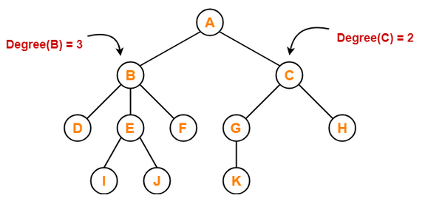
6. Degree-
Degree of a node is the total number of children of that node.
Degree of a tree is the highest degree of a node among all the nodes in the tree.

Slide 11
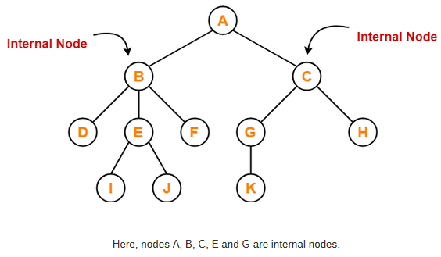
7. Internal Node-
The node which has at least one child is called as an internal node.
Internal nodes are also called as non-terminal nodes.
Every non-leaf node is an internal node.

Slide 12
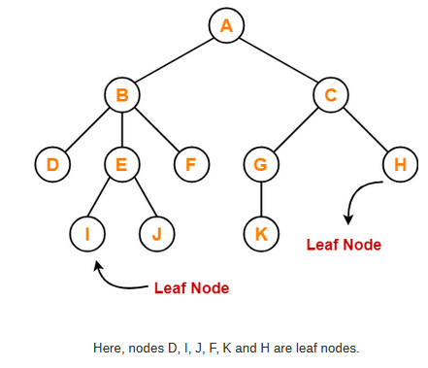
8. Leaf Node-
The node which does not have any child is called as a leaf node.
Leaf nodes are also called as external nodes or terminal nodes

Slide 13
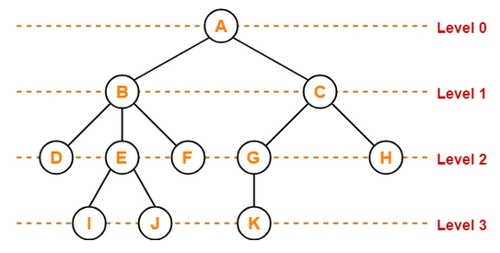
9. Level-
In a tree, each step from top to bottom is called as level of a tree.
The level count starts with 0 and increments by 1 at each level or step.

Slide 14
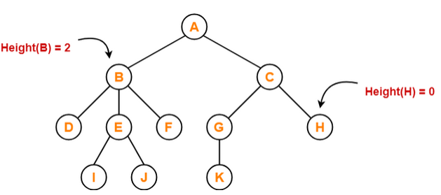
10. Height-
Total number of edges that lies on the longest path from any leaf node to a particular node is called as height of that node.
Height of a tree is the height of root node.
Height of all leaf nodes = 0

Slide 15
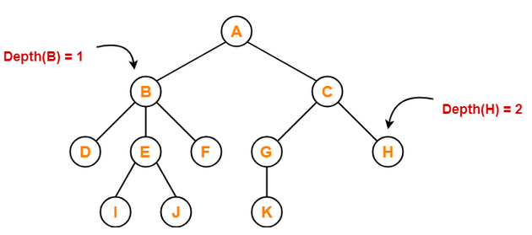
11. Depth-
Total number of edges from root node to a particular node is called as depth of that node.
Depth of a tree is the total number of edges from root node to a leaf node in the longest path.
Depth of the root node = 0
The terms “level” and “depth” are used interchangeably

Slide 16
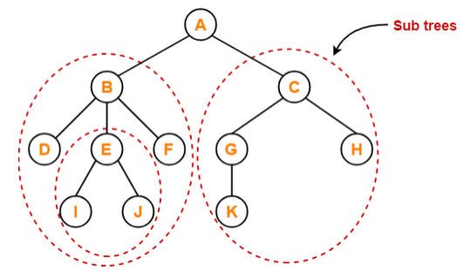
12. Subtree-
In a tree, each child from a node forms a subtree recursively.
Every child node forms a subtree on its parent node.

Slide 17
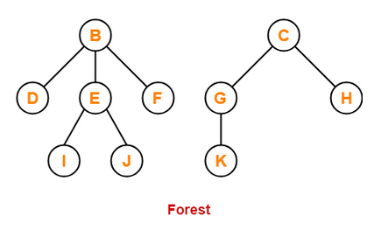
13. Forest-
A forest is a set of disjoint trees.
It is a disjoint set. If two elements are in the same tree, then they are in the same disjoint set. The root node (or the topmost node) of each tree is called the representative of the set. There is always a single unique representative of each set.

Slide 18
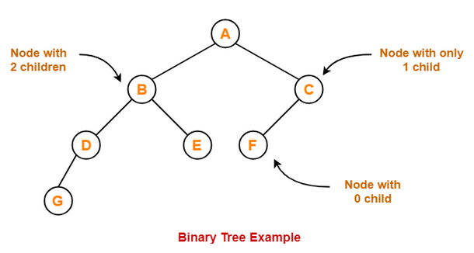
Binary Tree
Binary tree is a special tree data structure in which each node can have at most 2 children.
Thus, in a binary tree,
Each node has either 0 child or 1 child or 2 children.

Slide 19
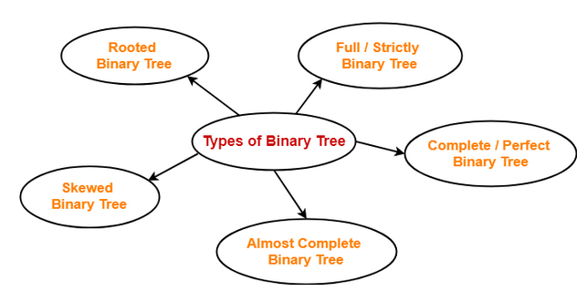
Types of Binary Trees-

Slide 20
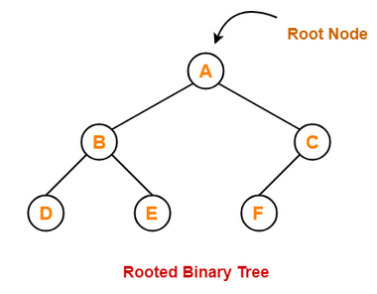
1. Rooted Binary Tree-
A rooted binary tree is a binary tree that satisfies the following 2 properties-
It has a root node.
Each node has at most 2 children.

Slide 21
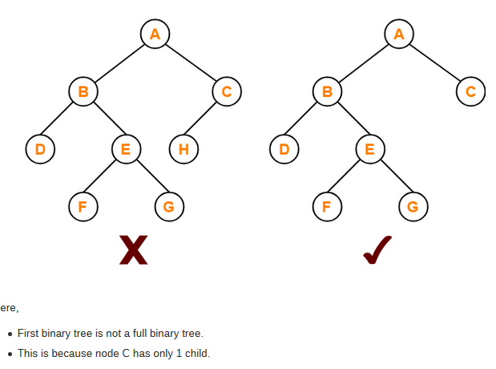
2. Full / Strictly Binary Tree-
A binary tree in which every node has either 0 or 2 children is called as a Full binary tree.
Full binary tree is also called as Strictly binary tree

Slide 22
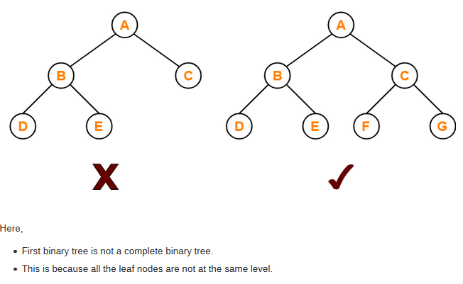
3. Complete / Perfect Binary Tree-
A complete binary tree is a binary tree that satisfies the following 2 properties-
Every internal node has exactly 2 children.
All the leaf nodes are at the same level.
Complete binary tree is also called as Perfect binary tree.

Slide 23
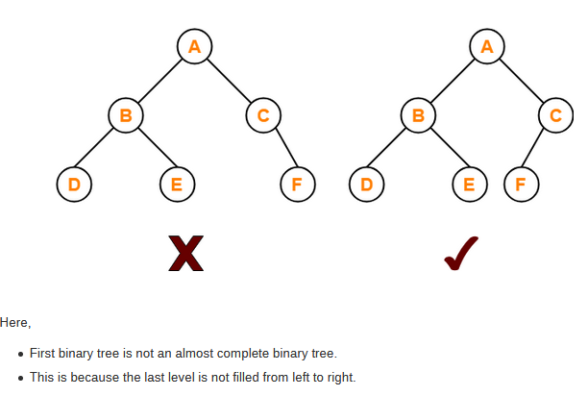
4. Almost Complete Binary Tree-
An almost complete binary tree is a binary tree that satisfies the following 2 properties-
All the levels are completely filled except possibly the last level.
The last level must be strictly filled from left to right.

Slide 24
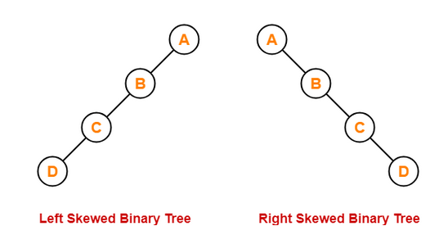
5. Skewed Binary Tree-
A skewed binary tree is a binary tree that satisfies the following 2 properties-
All the nodes has one and only one child.
The remaining node has no child.
OR
A skewed binary tree is a binary tree of n nodes such that its depth is (n-1).

Slide 25
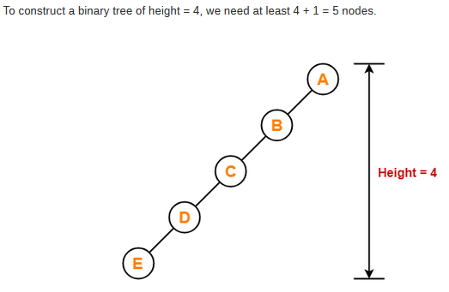
Binary Tree Properties-
Important properties of binary trees are-
Property-01:
Minimum number of nodes in a binary tree of height H
= H + 1

Slide 26
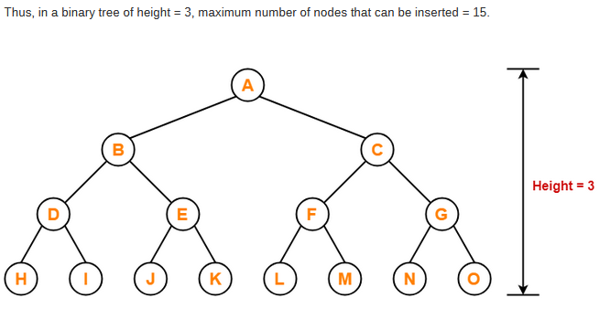
Property-02:
Maximum number of nodes in a binary tree of height H
= 2^{H+1} – 1
Example-
Maximum number of nodes in a binary tree of height 3
= 2³⁺¹ – 1
= 16 – 1
= 15 nodes

Slide 27
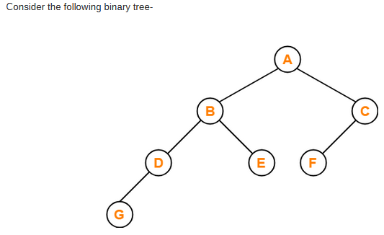
Property-03:
Total Number of leaf nodes in a Binary Tree
= Total Number of nodes with 2 children + 1
Here,
Number of leaf nodes = 3
Number of nodes with 2 children = 2
Clearly, number of leaf nodes is one greater than number of nodes with 2 children.
This verifies the above relation.

Slide 28
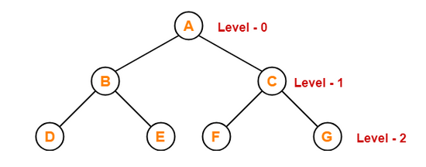
Property-04:
Maximum number of nodes at any level ‘L’ in a binary tree
= 2^{L}
Example-
Maximum number of nodes at level 2 in a binary tree
= 2²
= 4
Thus, in a binary tree, maximum number of nodes that can be present at level 2 = 4.

Slide 29
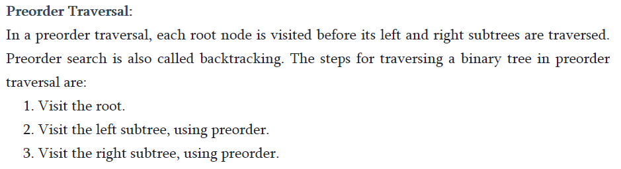
Traversing in the Binary Tree
Preorder Traversal

Slide 30
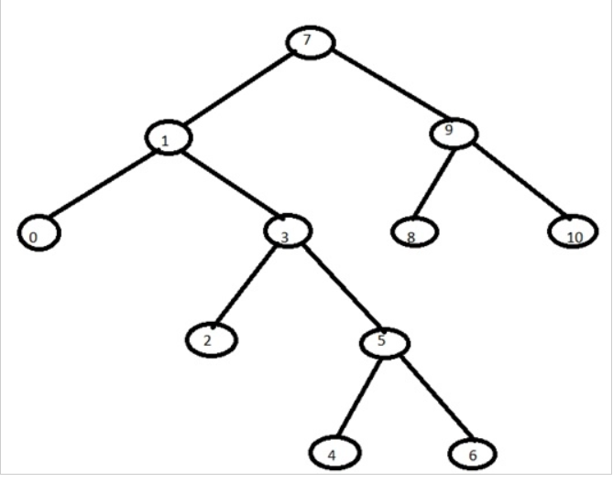
Example of Preorder Traversal
preorder traversal of the above tree will be: 7,1,0,3,2,5,4,6,9,8,10

Slide 31
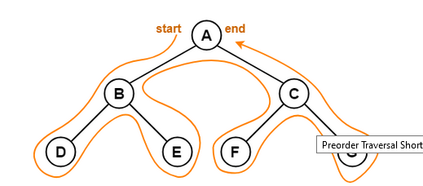
Preorder Traversal?
Applications-
Preorder traversal is used to get prefix expression of an expression tree.
Preorder traversal is used to create a copy of the tree.

Slide 32
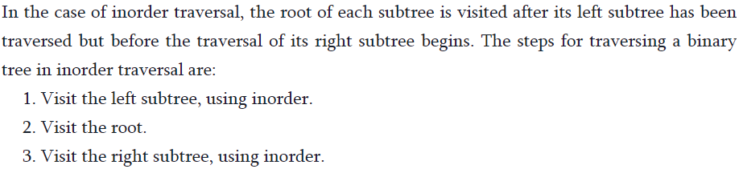
Inorder Traversal

Slide 33

Example of Inorder Traversal

Slide 34
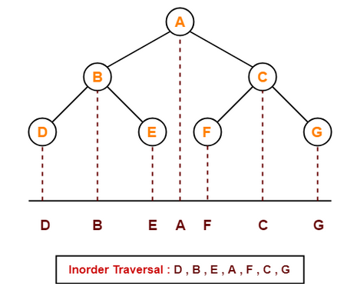
Inorder Traversal Shortcut
Application-
Inorder traversal is used to get infix expression of an expression tree.

Slide 35
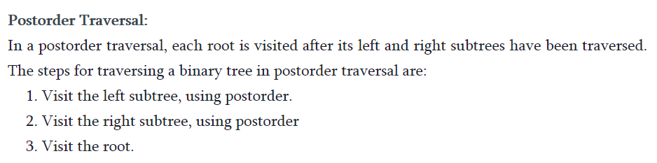
Postorder Traversal

Slide 36
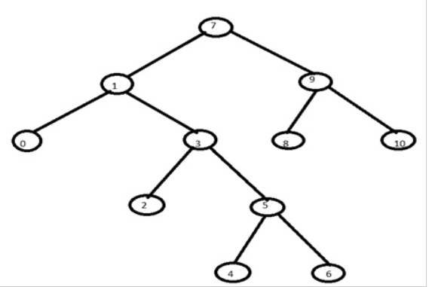
Example of Postorder Traversal

Slide 37
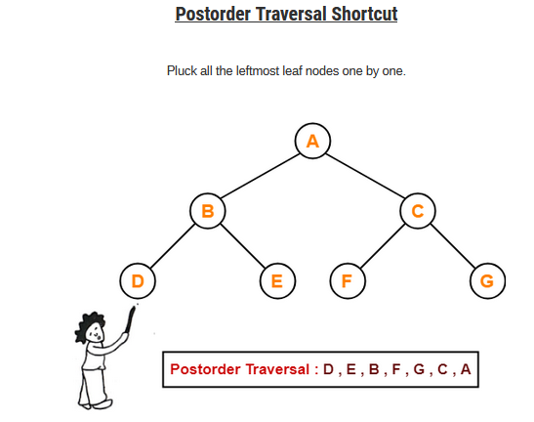
Applications-
Postorder traversal is used to get postfix expression of an expression tree.
Postorder traversal is used to delete the tree.
This is because it deletes the children first and then it deletes the parent.

Slide 38
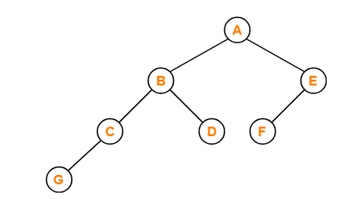
Problem-01:
If the binary tree in figure is traversed in inorder, then the order in which the nodes will be visited is ____?
Problem-02:
Which of the following sequences denotes the postorder traversal sequence of the tree shown in figure?

Slide 39
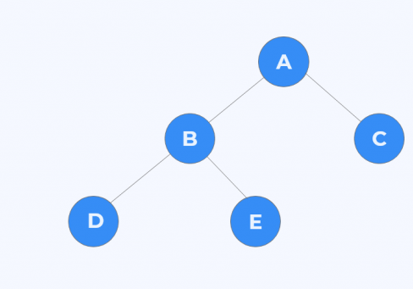
Problem-03:
Find out the Preorder, Inorder and Postorder Traversal.

Slide 40
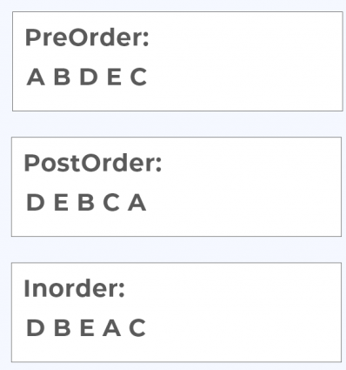

Slide 41
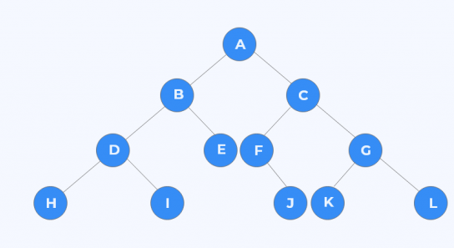
Problem-04:
Find out the Preorder, Inorder and Postorder Traversal.

Slide 42
Pre-order= ABDHIECFJGKL
Postorder = HIDEBJFKLGCA
Inorder = HDIBEAFJCKGL

Slide 43


Slide 45
First node in pre-order traversal is root node of the binary tree, thus A is the root node.
In in-order traversal first left then root and then right tree traversed.

Slide 47
Now first consider the left sub tree, the pre order and in order sequences of left sub tree are

Slide 54
Binary Search Tree (BST)
Binary tree with following properties –
Every element has a unique key.
The left sub tree of a node contains only nodes with keys less than the root node's key.
The right sub tree of a node contains only nodes with keys greater than the root node's key.
The left and right sub trees are also binary search trees.
Binary Search Trees (BST) are a type of binary trees with a special organization of data
This data organization leads to O(log n) complexity for searches, insertions and deletions
in certain types of the BST (balanced trees). But for worst case it would be O(n).
For getting all advantages of BST, it should be AVL or height balance tree.

Slide 55
BST Examples
45
G
33
54
J
E
22
47
56
B
K
H
25
A
D

Slide 58
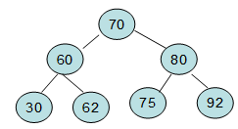
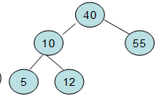
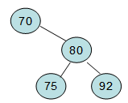

Slide 61
* Should be there before root

Slide 72
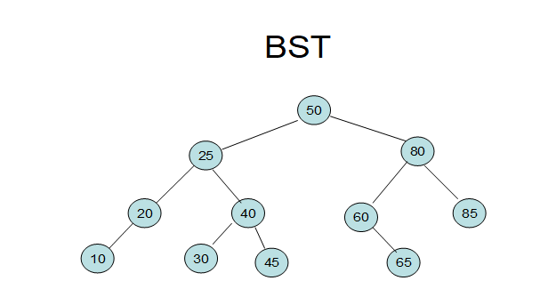

Slide 73
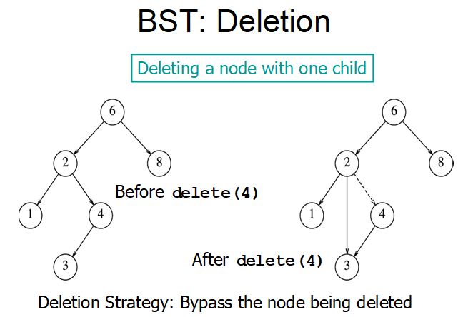

Slide 74
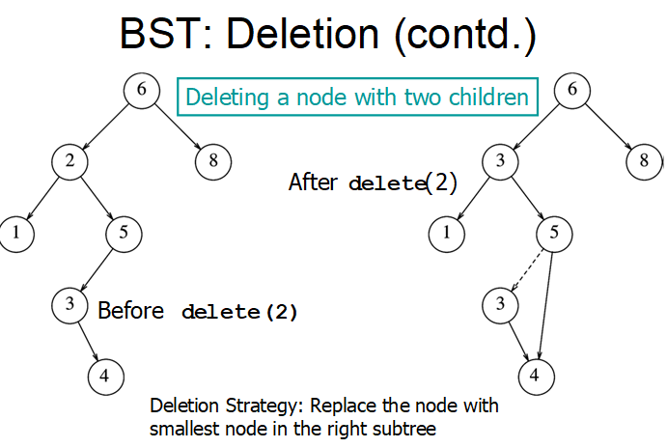

Slide 75

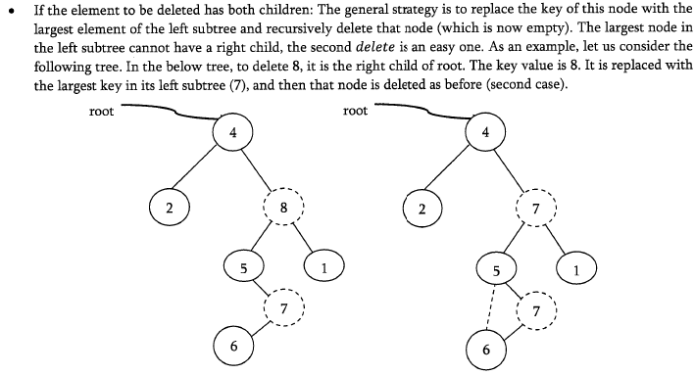

Slide 76
Thank You

